Slide 1
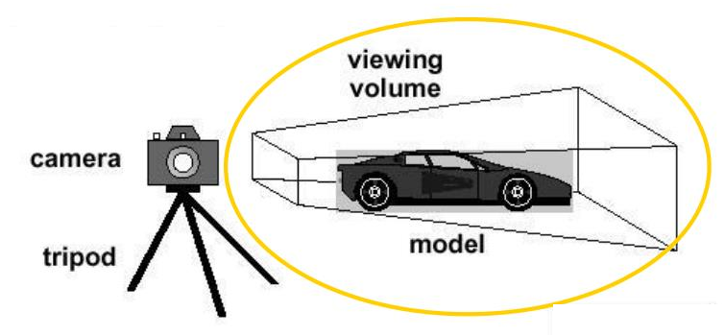
3D Viewing
3D viewing
In 2D we specify a window on 2D world and a view port on 2D view surface
Objects in world are clipped against window and are then transformed into view port for display.
Added complexity caused by
i. added dimension
ii. display devise are only 2D
Solution is accomplished by introducing projections that transform 3D objects onto 2D plane

Slide 2
3D Viewing
3D viewing issues
Projection
Depth
Lighting effects, Shading
Shadows
Transparency
etc

Slide 3
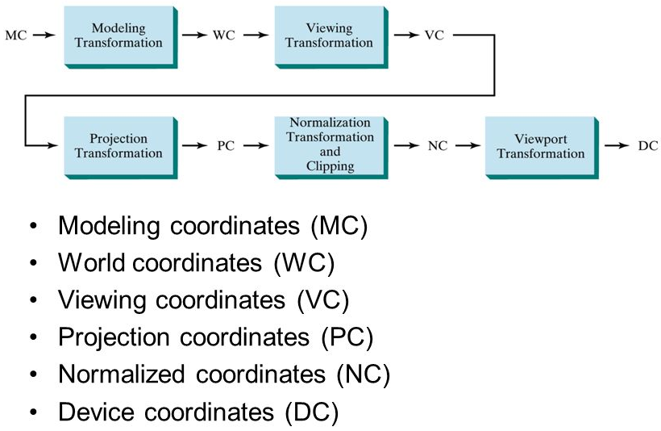
3D Viewing
PC: Projection Coord.

Slide 4
Matrix Representation of 3D Transformations
2D transformations represented by 3 x 3 matrices using homogenous coordinates,
3D transformations can be represented by 4 x 4 matrices, providing using homogeneous coordinate representations
Representing a 3D point P(x , y ,z) , we represent if as
P (x , y , z, H), where two these quadruples represent the same point it one is a non zero multiple of the other the quadruple (0,0,0,0) is not allowed.
A standard representation of a point (x , y ,z ,H) with H not zero is given by (x/H , y/H, z/H, 1).
Transforming the point to this form is called homogenizing.

Slide 5
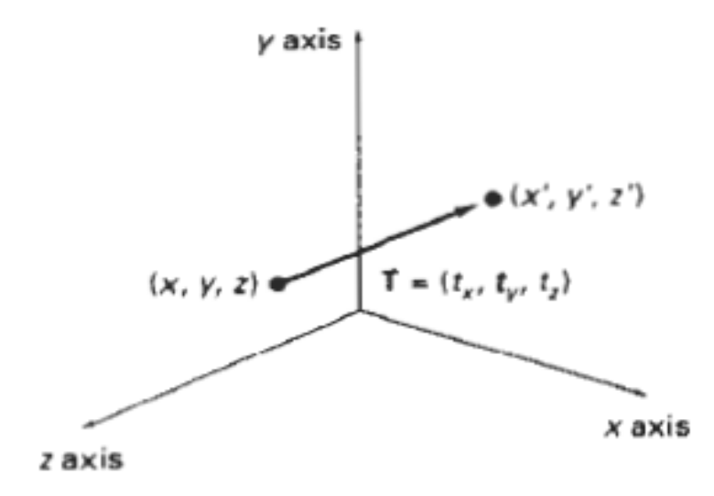
Matrix Representation of 3D Transformations
Translation:
A point is translated from position P=(x,y,z) to position
P’ = (x’,y’,z’) with the matrix operation
x’ 1 0 0 t_{x} x
y’ = 0 1 0 t_{y} . y
z’ 0 0 1 t_{z} z
1 0 0 0 1 1
or P’ = T.P
Parameters t_{x} , t_{y} ,t_{z} specify translation distances for the coordinate directions x ,y and z.
This matrix representation is equivalent to three equations:
x’ = x + t_{x} y’ = y + t_{y} z’ = z + t_{z}

Slide 6
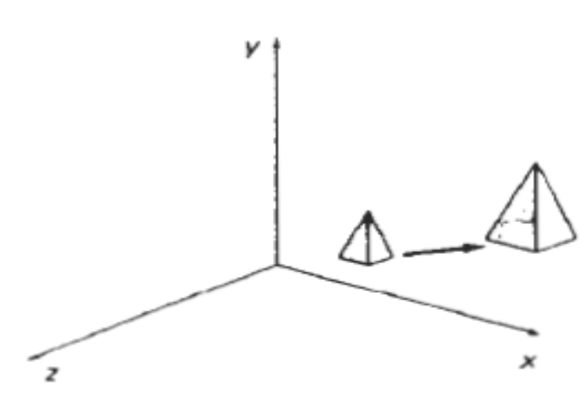
Matrix Representation of 3D Transformations
Scaling:
Scaling changes size of an object and repositions the object relative to the coordinate origin.
If transformation parameters are not all equal then figure gets distorted
So we can preserve the original shape of an object with uniform scaling(s_{x=} s_{y=} s_{z})
Matrix expression for scaling transformation of a position P = (x,y,z) relative to the coordinate origin can be written as :
x’ s_{x} 0 0 0 x
y’ 0 s_{y} 0 0 . y
z’ = 0 0 s_{z} 0 z
1 0 0 0 1 1
or P’ = S . P

Slide 7
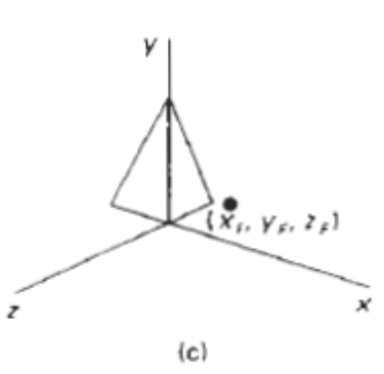
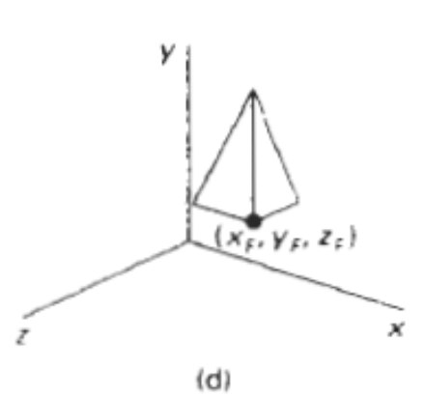
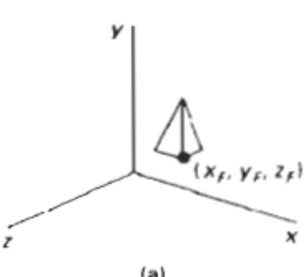
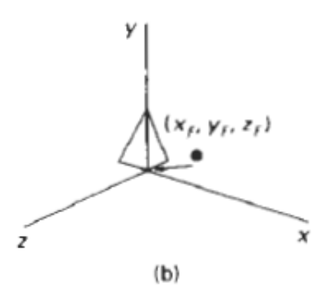
Matrix Representation of 3D Transformations
Scaling with respect to a selected fixed point (x_{f ,} y_{f ,} z_{f}) can be represented with:
i. Translate fixed point to the origin
ii. Scale object relative to the coordinate origin
iii. Translate fixed point back to its original position
CM = T(x_{f ,} y_{f ,} z_{f}) . S(s_{x ,} s_{y ,} s_{z}) .T(-x_{f ,} -y_{f ,} -z_{f})

Slide 8
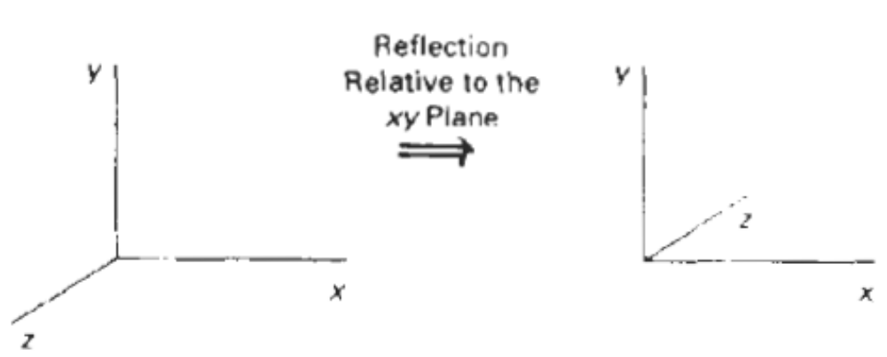
Matrix Representation of 3D Transformations
Reflection:
Reflections with respect to a plane are equivalent to 180* rotations in four dimensional space.
Reflection of an object about plane xz
1 0 0 0 x
P’ = 0 -1 0 0 y
0 0 1 0 z
0 0 0 1 1

Slide 9
Matrix Representation of 3D Transformations
Reflection:
Reflections with respect to a plane are equivalent to 180* rotations in four dimensional space.
1 0 0 0
RFz = 0 1 0 0
0 0 -1 0
0 0 0 1
This transformation changes the sign of the z coordinates, leaving the x and y coordinate values unchanged.
Transformation matrices for inverting x and y values are defined similarly, as reflections relative to the yz plane and xz plane.

Slide 10
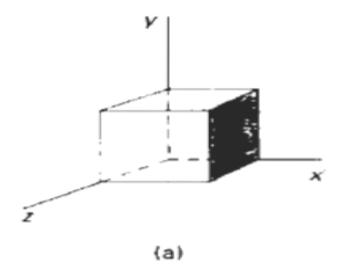
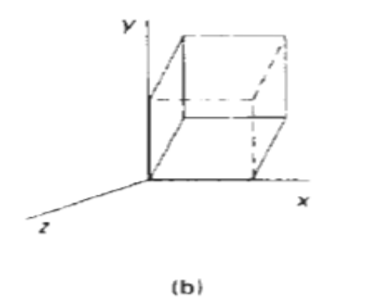
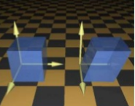
Matrix Representation of 3D Transformations
Shearing (non rigid body):
Shearing transformations are used to modify object shapes.
e.g. shears relative to the z axis:
1 0 a 0
SHz = 0 1 b 0
0 0 1 0
0 0 0 1
where parameters a and b assume any real values.
It alters the x and y coordinate values by an amount that is proportional to the z value while leaving the z coordinate unchanged.

Slide 11
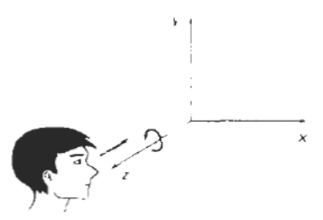
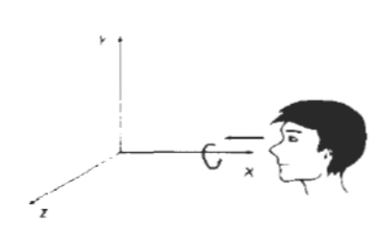
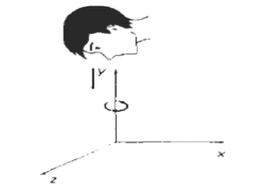
Matrix Representation of 3D Transformations
Rotation:
Designate the axis of rotation about which the object is to be rotated and the amount of angular rotation .
Axes that are parallel to the coordinate axes are easy to handle.

Slide 12
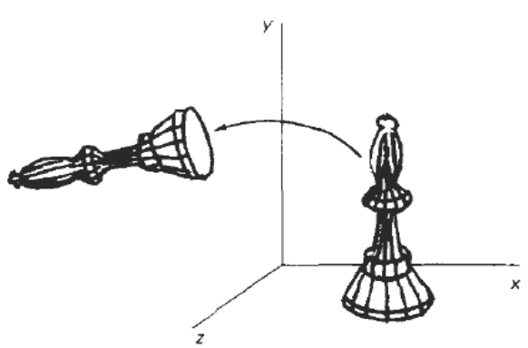
Matrix Representation of 3D Transformations
Coordinate axes Rotations:
3D y-axis rotation in ccw equations are :
z’ = zcosθ - xsinθ y’ = y …………(i)
x’ = zsinθ + xcosθ
x -> y -> z ->x
3D z-axis rotation equations are expressed in homogenous coordinate form as
x’ cosθ 0 sinθ 0 x
y’ = 0 1 0 0 . y
z’ -sinθ 0 cosθ 0 z
1 0 0 0 1 1
P’ = Rz (θ) . P

Slide 13
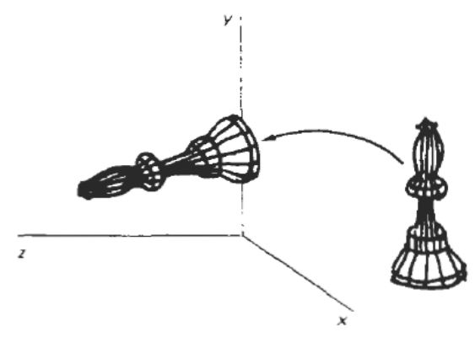
Matrix Representation of 3D Transformations
Cyclic permutation of the coordinate parameters x , y and z are used to get transformation equations for rotations about the other two coordinates
z’ = zcosθ - xsinθ x’ = zsinθ + xcosθ y’ = y …(i)
substituting permutations in (i) for an x axis rotation we get,
y’ = ycosθ - zsinθ z’ = ysinθ + zcosθ x’ = x
3D x-axis rotation equations in homogenous coordinate form as
x’ 1 0 0 0 x
y’ = 0 cosθ -sinθ 0 . y
z’ 0 sinθ cosθ 0 z
1 0 0 0 1 1
P’ = Rx (θ) . P
Rotation about y axis in anticlockwise direction matrix/eq

Slide 14
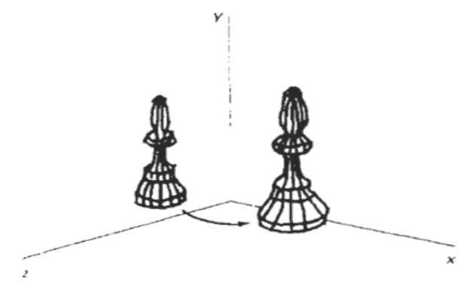
Matrix Representation of 3D Transformations
z’ = zcosθ - xsinθ x’ = zsinθ + xcosθ y’ = y …(i)
substituting permutations in (i) for a y axis rotation we get,
z’ = zcosθ - xsinθ x’ = zsinθ + xcosθ y’ = y
3D y-axis rotation equations are expressed in homogenous coordinate form as
x’ cosθ 0 sinθ 0 x
y’ = 0 1 0 0 . y
z’ -sinθ 0 cosθ 0 z
1 0 0 0 1 1
or, P’ = Ry (θ) . P

Slide 15
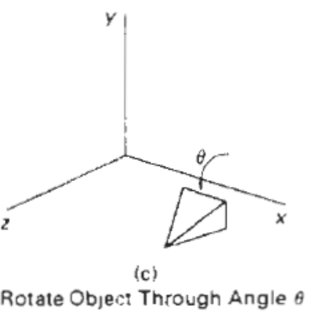
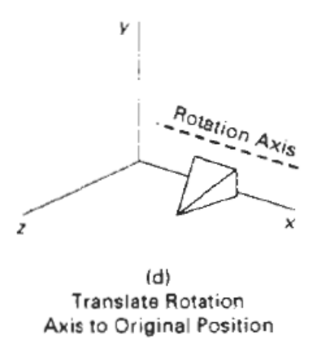
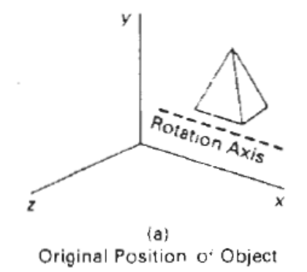
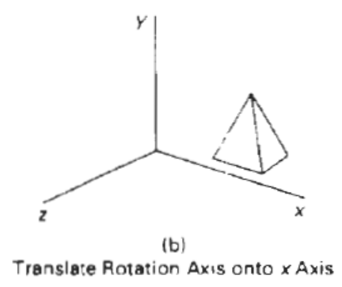
Matrix Representation of 3D Transformations
Rotation about an axis parallel to one of the coordinate axes :
Steps:
Translate object so that rotation axis coincides with the parallel coordinate axis.
ii. Perform specified rotation about that axis
iii. Translate object back to it’s original position.
ie. P’ = T⁻¹ . R_{x}(θ) . T . P

Slide 16
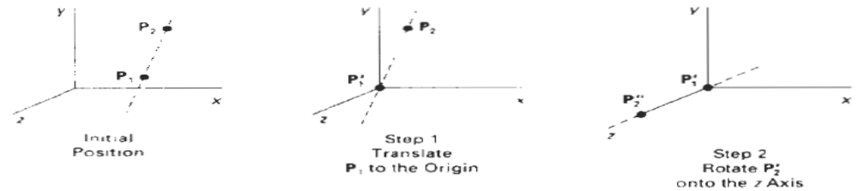
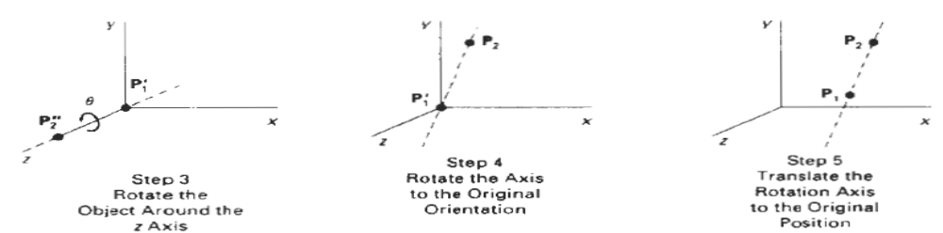
Matrix Representation of 3D Transformations
Rotation about an axis NOT parallel to one of the coordinate axes
Steps:
An arbitrary axis in space passing thru point (x₀, y₀, z₀)
Steps required for rotation about this axis by some angle θ are:
i. Translate so that point(x₀, y₀, z₀) is at the origin of the coordinate system
ii. Perform rotations to make axis of rotation coincident with the z axis
iii.Rotate about the z axis by the angle θ.
iv.Perform the inverse of the combined rotation transformation
v. Perform the inverse of the translation.

Slide 17
Matrix Representation of 3D Transformations
Rotation about an axis NOT parallel to one of the coordinate axes
Steps:
An arbitrary axis in space passing thru point (x₀, y₀, z₀)
Steps required for rotation about this axis by some angle θ are:
i. Translate so that point(x₀, y₀, z₀) is at the origin of the coordinate system
ii. Perform rotations to make axis of rotation coincident with the z axis
iii.Rotate about the z axis by the angle θ.
iv.Perform the inverse of the combined rotation transformation
v. Perform the inverse of the translation.

Slide 18
Rotation about z axis ccw
x’ = x cosѳ - ysinѳ
y’= x sinѳ + ycosѳ
z’= z
x->y->z->x
x’ = cosѳ -sinѳ 0 0 x
y’ = sinѳ cosѳ 0 0 y
z’ = 0 0 0 0 z
1 0 0 0 1 1

Slide 19
Rotation about an Arbitrary Axis
Steps
Translate (x₁, y₁, z₁) to the origin
Rotate (x’₂, y’₂, z’₂) on to the z axis
Rotate the object around the z-axis
Rotate the axis to the original orientation
Translate the rotation axis to the original position
z
(x2,y2,z2)
(x1,y1,z1)
y
y
y
(x2,y2,z2)
x
(x1,y1,z1)
l
x
θ
x
z
z

Slide 20
y
(x2,y2,z2)
(x1,y1,z1)
x
z

Slide 21
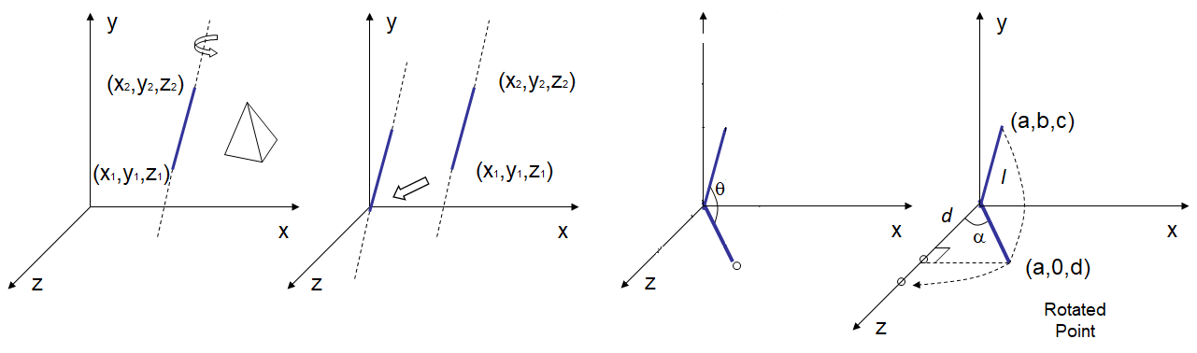
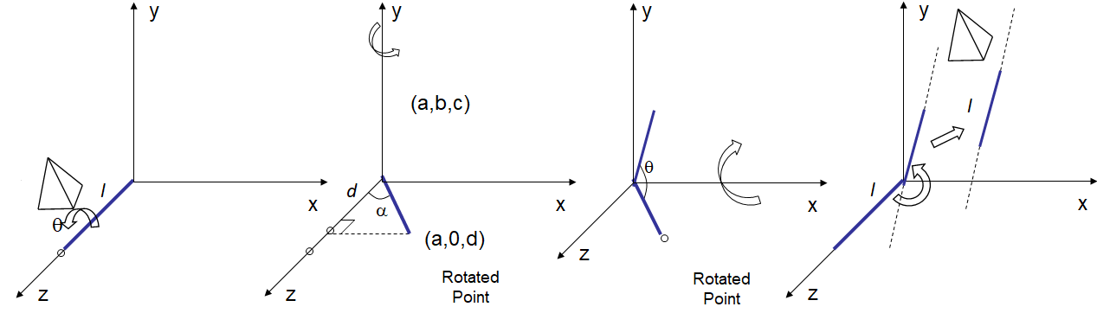
Rotation about an Arbitrary Axis
cm = T’_{(x1,y1,z1)} . R’_{X} . R’_{y} . R_{z} . R_{y} . R_{X} . T_{(-x1,-y1,-z1)}

Slide 22
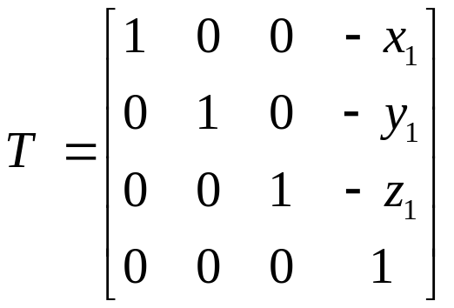
Rotation about an Arbitrary Axis
Step 1
Translate (x₁, y₁, z₁) to the origin
y
(x2,y2,z2)
(x1,y1,z1)
x
z

Slide 23
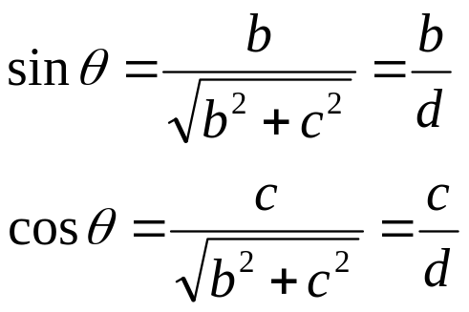
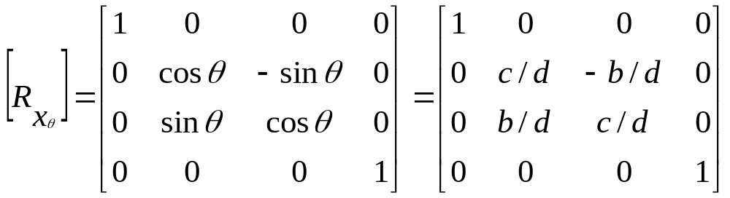
Rotation about an Arbitrary Axis
Step 2
Rotate the line about x axis in anti clockwise direction by ‘θ’ angle
y
(0,b,c)
(a,b,c)
Projected Point
θ
θ
x
(a,0,?)
z
Rotated Point

Slide 24
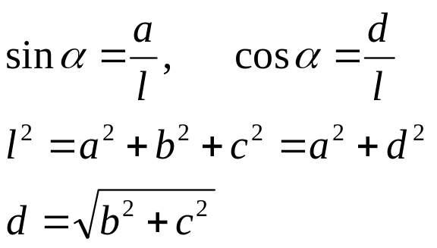
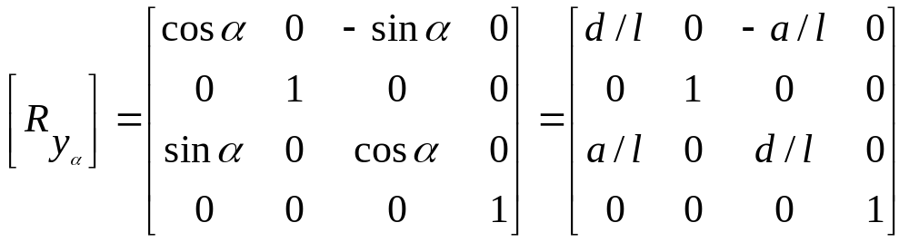
Rotation about an Arbitrary Axis
Step 3
Rotate the line about y axis in clockwise direction by ‘α’ angle
y
(a,b,c)
Projected Point
l
d
l
x
α
(a,0,d)
Rotated Point
z

Slide 25
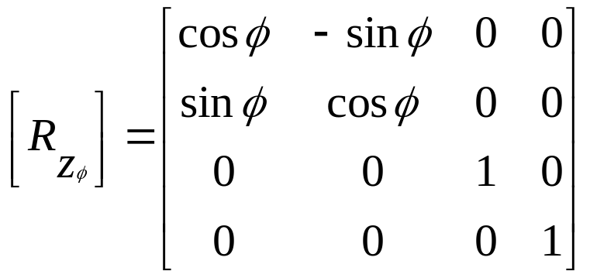
Rotation about an Arbitrary Axis
Step 4
Rotate the object about the line that has been aligned with z axis by the desired angle ‘φ’
y
l
x
z

Slide 26
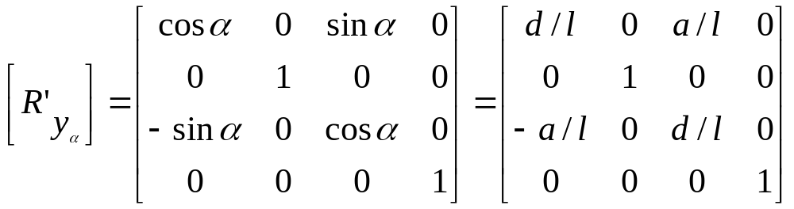
Rotation about an Arbitrary Axis
Step 5
(apply reverse transformations to place the arbitrary axis along with the reflected object back to its original position)
Rotate the line about y axis in anti clockwise direction
y
d
α
x
(a,0,d)
Rotated Point
z

Slide 27
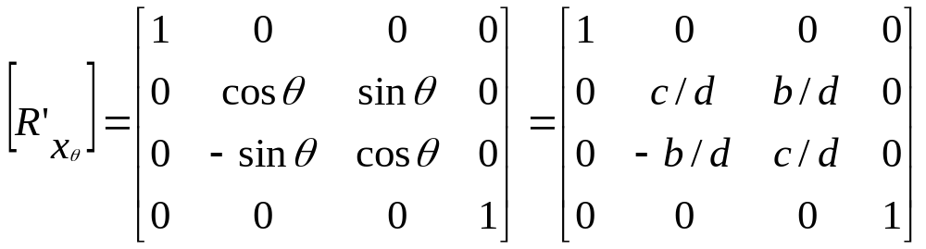
Rotation about an Arbitrary Axis
Step 6
Rotate the line about x axis in clockwise direction
y
θ
x
z
Rotated Point

Slide 28
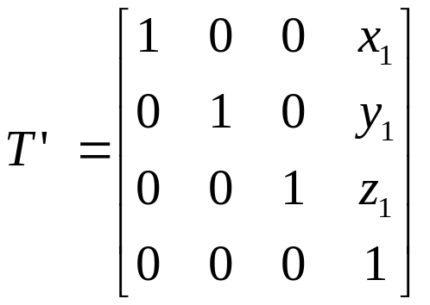
Rotation about an Arbitrary Axis
Step 7
Translate the line back to its original location
y
l
l
x
z

Slide 29
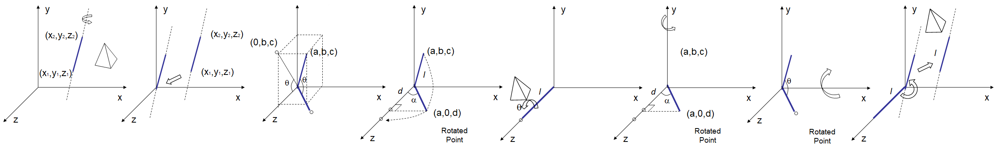
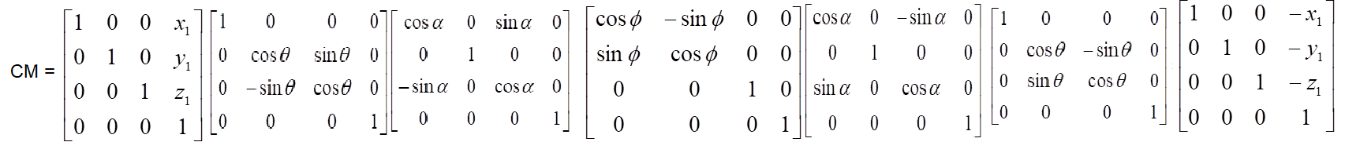
Rotation about an Arbitrary Axis

Slide 30
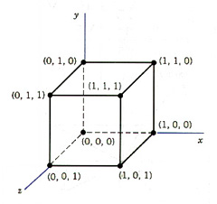
Rotation about an Arbitrary Axis
How will you rotate a unit cube 90º about an axis defined by its endpoints A(2,1,0) and B(3,3,1).
cm = T’_{(x1,y1,z1)} . R’_{X} . R’_{y} . R_{z} . R_{y} . R_{X} . T_{(-x1,-y1,-z1)}

Slide 31
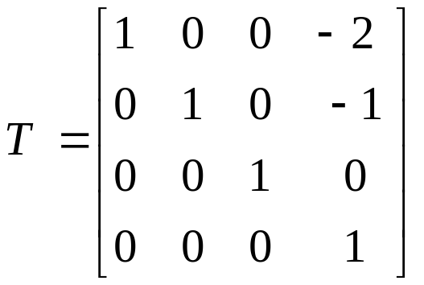
How will you rotate a unit cube 90º about an axis defined by its endpoints A(2,1,0) and B(3,3,1).
Step 1
Translate end point A (2, 1, 0) to the origin
y
(3,3,1)
(1,2,1)
(2,1,0)
(0,0,0)
x
z

Slide 32
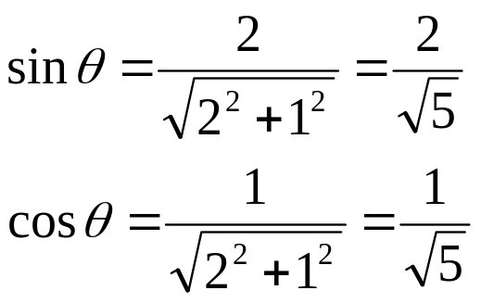
How will you rotate a unit cube 90º about an axis defined by its endpoints A(2,1,0) and B(3,3,1).
Step 2
Rotate the line about x axis in anti clockwise direction by ‘θ’ angle
y
(0,2,1)
(1,2,1)
Projected Point
θ
θ
x
z
Rotated Point

Slide 33
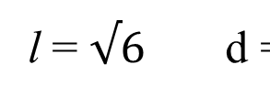
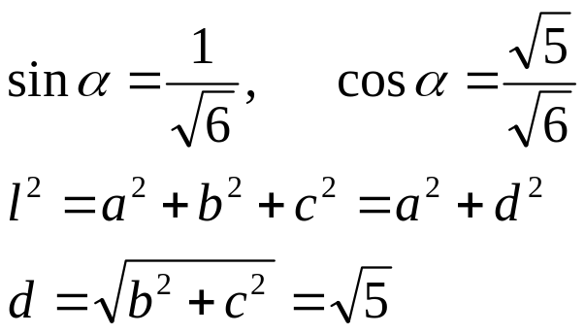
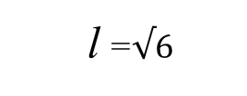
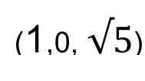
Rotation about an Arbitrary Axis
Step 3
Rotate the line about y axis in clockwise direction by ‘α’ angle
y
Projected Point
d
α
x
Rotated Point
z

Slide 34
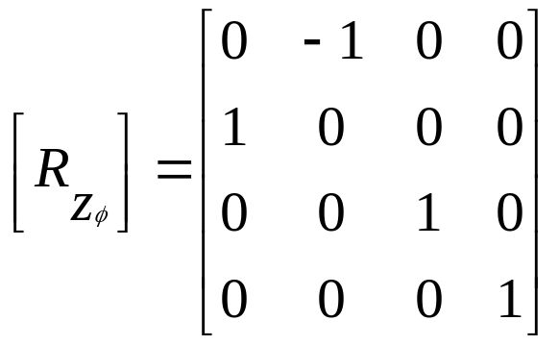
Rotation about an Arbitrary Axis
Step 4
Rotate the object about the line that has been aligned with z axis by the desired angle ‘φ’
y
l
x
θ
z

Slide 35
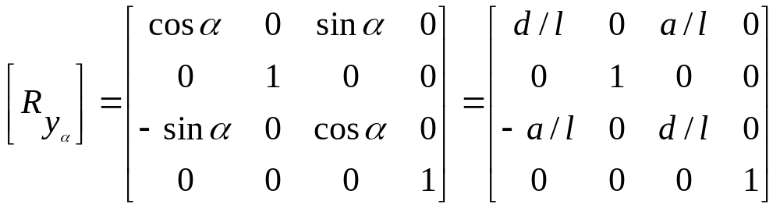
Rotation about an Arbitrary Axis
Step 3
Rotate the line about y axis in clockwise direction by ‘α’ angle
y
Projected Point
d
α
x
Rotated Point
z

Slide 36
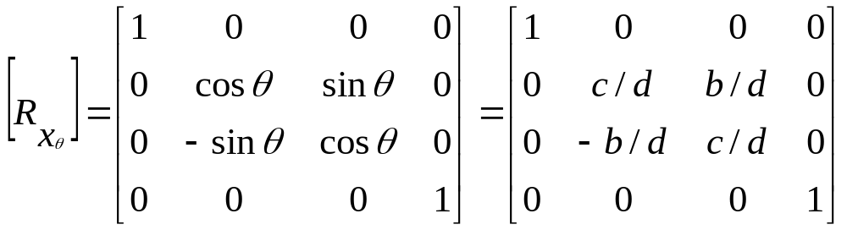
How will you rotate a unit cube 90º about an axis defined by its endpoints A(2,1,0) and B(3,3,1).
Step 2
Rotate the line about x axis in anti clockwise direction by ‘θ’ angle
y
(0,2,1)
(1,2,1)
Projected Point
θ
θ
x
z
Rotated Point

Slide 37
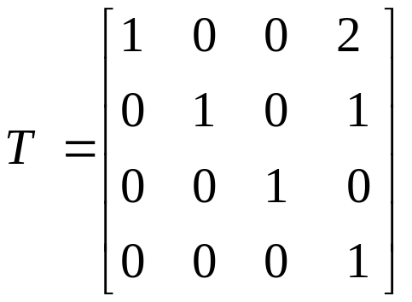
How will you rotate a unit cube 90º about an axis defined by its endpoints A(2,1,0) and B(3,3,1).
Step 1
Translate end point A (2, 1, 0) to the origin
y
(3,3,1)
(1,2,1)
(2,1,0)
(0,0,0)
x
z

